Slide 1

Online Electronic Store
Project Supervisior:
Ms. Komal Salgotra
Team Members:
1.Anupam Gupta
2.Mohit Yadav
3.Divya Gupta

Slide 2

Introduction
Every organization, whether big or small, has challenges to overcome and managing the information of Product Type, Product, Customer, Order, Payment. Every Online Electronic Store has different Product needs, therefore we design exclusive employee management system that are adapted to your managerial requirements.

Slide 3
Online Electronic Store Overview
The applications are reduced as much as possible to avoid errors while entering the data.
It also provides error message while entering invalid data. No formal knowledge is needed for the user this system. Thus by this all it proves it is user-friendly.
Online Electronic Store, as described above, can lead to error free, secure, reliable and fast management system.
It can assist the user to concentrate on their other activities rather to concentrate on the record keeping.

Slide 4




Software Requirements
LAMP Stack
XAMPP Server
MAMP Server
WAMP Server

Slide 5
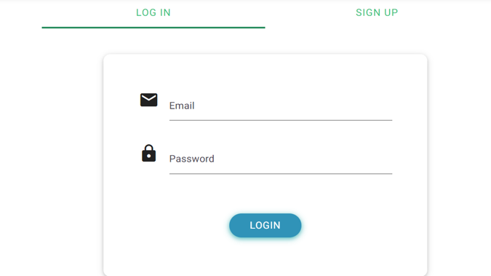
Features of the Project
User Registration
User login system
Change password
Forgot password
Profile management system
Shopping cart
Wishlist
Order History

Slide 6
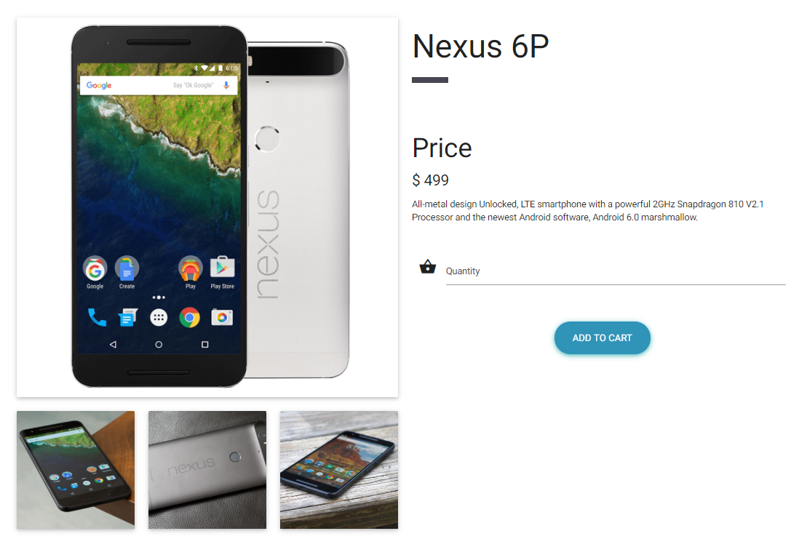
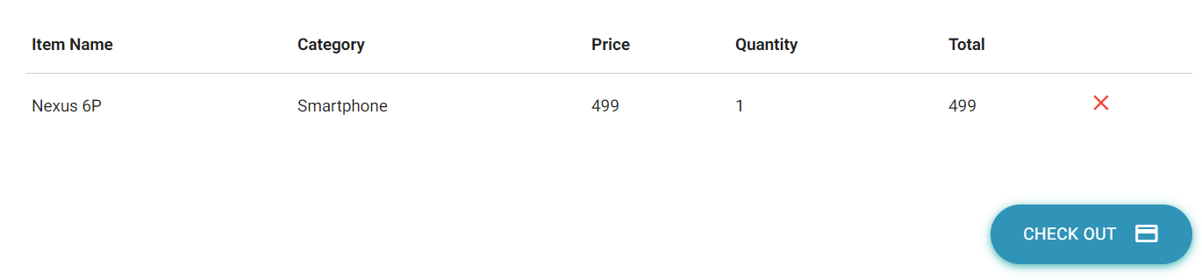
Features of User
Signing up for a user account
Change e-mail id and password
Add items to a cart/basket prior to purchasing
Generating invoice of all items and printing them in pdf form
Purchasing items and delivering them to a specific address

Slide 7
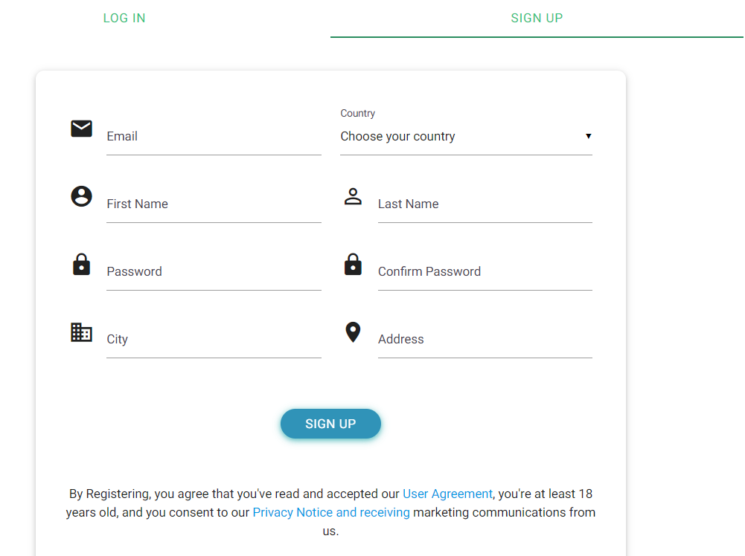
Functional Requirements
Registration
Login
Changes to Cart
Payment
Logout
Report Generation
Review
Orders

Slide 8



Non-functional requirements
Secure access of confidential data (customer details)
24 x 7 availability
Better component design to get better performance at peak time.
Flexible service-based architecture will be highly desirable for future extension.
Various other non-functional requirements include:
Reliability
Security
Maintainability
Portability
Reusability
Compatibility
Resource Utilization

Slide 9

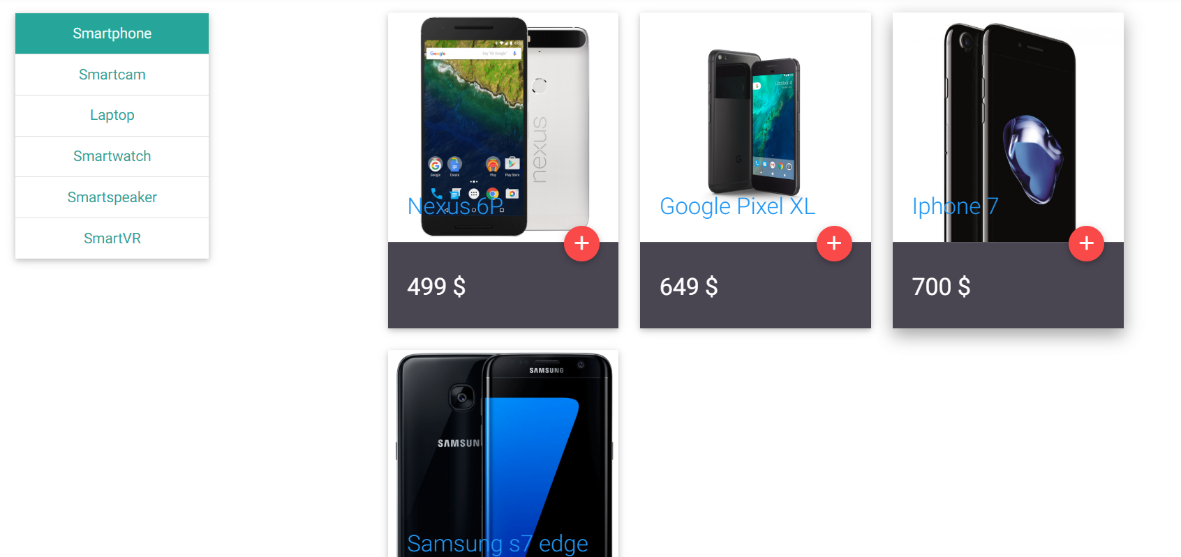
Products:

Slide 10
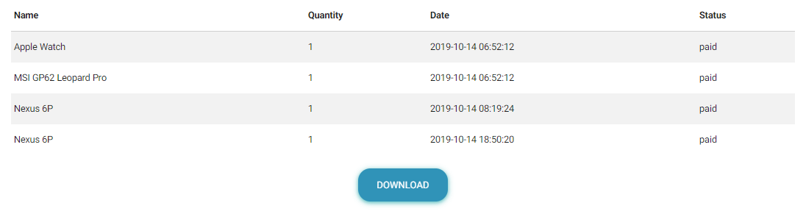
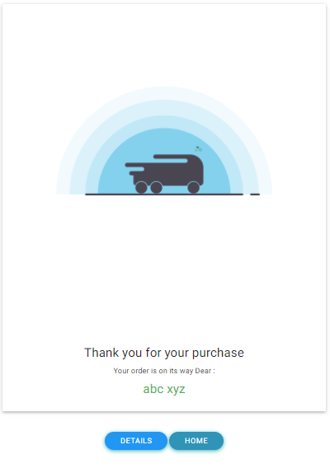
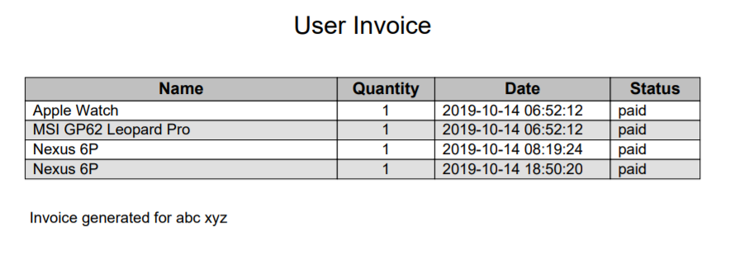
Order Confirmation:
The following confirmation screen will appear once the payment is done

Slide 11
Conclusion
Online electronic stores offer a wide range of benefits to customers, including convenience, lower prices, a wider selection of products, and the ability to compare prices.
Read reviews before making a purchase. However, it is important to take steps to ensure the security of your personal and financial information.
When shopping online, and to choose stores that offer excellent customer service and support.

Slide 12
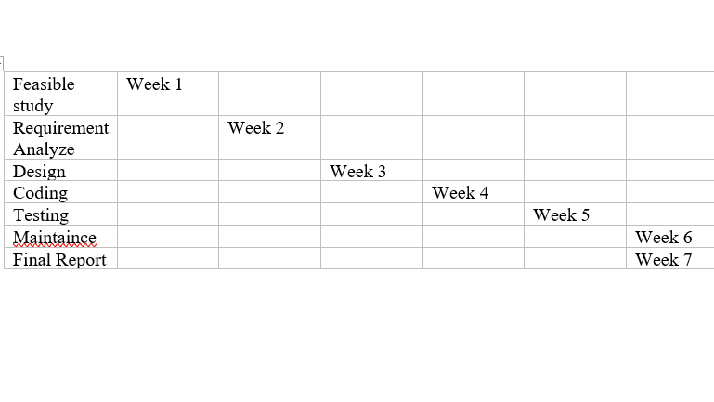
GANTT CHART

